Slide 1
Black & White Image Colorization
Mouliraj S
613521104308

Slide 2
Introduction:
1.Black and white photography has a rich history that dates back to the early 19th century.
2.It emerged as the primary form of photography for nearly a century before the advent of color photography.
Significance
1.Black and white photography played a pivotal role in documenting historical events, people, and landscapes.
2.It served as a medium for artistic expression, capturing raw emotions and dramatic contrasts.
The simplicity of black and white images often evokes a sense of timelessness and nostalgia.

Slide 3
What is Image Colorization?
1
2
3
Definition
Image colorization is the
process of adding color to black and white or grayscale images
How it Works
Image colorization can be performed manually or using automated algorithms
Key Components
Large datasets of both black and white and colored images are essential for training machine learning models

Slide 4
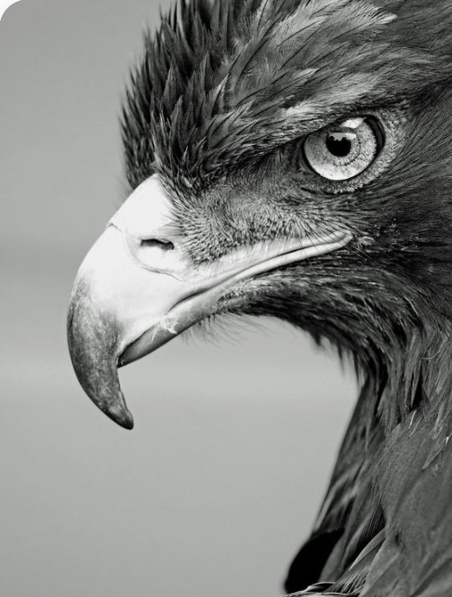
Neural Network Architecture
Deep neural networks, particularly convolutional neural networks (CNNs), are commonly used for image colorization tasks

Slide 5
Training Process
1.During training, the network learns to map grayscale input images to plausible color distributions by minimizing a predefined loss function.
2.Backpropagation is used to adjust the model's parameters iteratively, optimizing its ability to generate accurate colorizations.

Slide 6
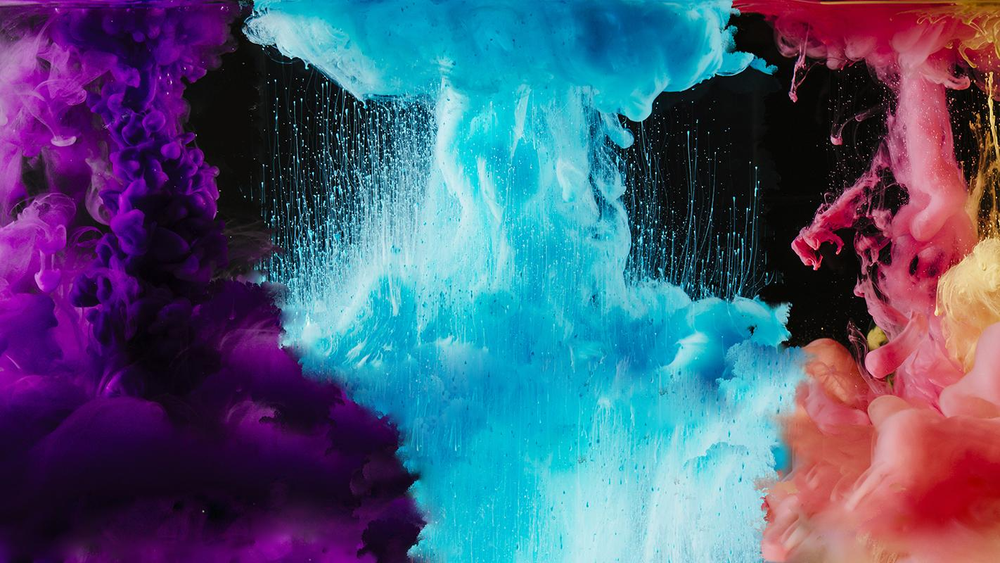
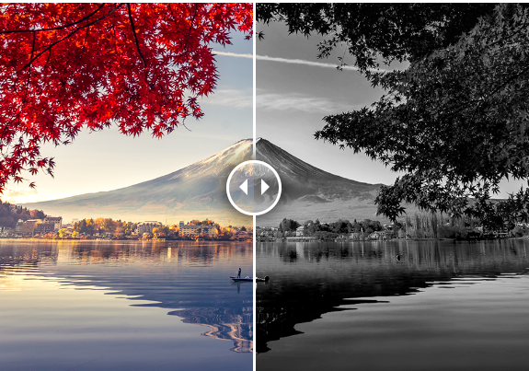
Examples of Colorized Images
1.Showcase a selection of black and white photos before and after colorization
2.Highlight the transformation and impact of adding color to historical images

Slide 7
Applications of Image Colorization
Historical Preservation
Education and Research
Entertainment Industry
Personal Photography
Marketing and Advertising
Digital Art and Creative Expression

Slide 8
Conclusion
1.Image colorization technology offers a compelling blend of artistry and nnovation, revitalizing black and white photographs with vibrant colors and immersive details.
2.From historical preservation and entertainment to personal photography and scientific research, the applications of image colorization are diverse and far-reaching.

Slide 9
Thank You

